Slide 1








“THE MAGIC OF MUSIC”
MUSIC IN THE LIBRARY AND HOW TO GET THE MOST OUT OF IT
A GUIDE BY ASHLEY MILLS MONAGHAN

Slide 2


What are we learning about today?
1. BEING INTENTIONAL WITH THE MUSIC IN YOUR LIBRARY AND STORY TIMES & WHY YOU SHOULD USE MORE OF IT AND HOW TO GET THE MOST OUT OF IT!
  THE LINK BETWEEN RHYTHM/MUSIC AND LITERACY - MAKE BETTER READERS THROUGH THE MAGIC OF MUSIC!
  IDEAS TO USE FROM MY OWN CURRICULUM, SAMPLINGS OF MY MUSIC AND BOOK AND WAYS TO USE THEM IN YOUR CLASSES
4 . ADDITIONAL RESOURCES FOR YOU!

Slide 3






LET’S TAKE CARE OF BUSINESS FIRST
ASHLEY MILLS MONAGHAN’S MUSIC IS AVAILABLE ANYWHERE YOU GET YOUR MUSIC. SEARCH ‘ASHLEY MILLS MUSIC’ ON SPOTIFY, AMAZON MUSIC, IHEARTRADIO, DEEZER, APPLE MUSIC, ITUNES ETC TO ACCESS SONGS AND CHECK OUT MY YOUTUBE CHANNEL FOR MORE TUTORIALS.
“A LITTLE GOES A LONG WAY” IS AVAILABLE ON AMAZON. THE AUDIO BOOK IS AVAILABLE ON ALL STREAMING PLATFORMS AND AUDIBLE!
CLICK ON TEACHER RESOURCES TAB
WWW.ASHLEYMILLSMONAGHAN.COM
@ASHLEYMILLSMONAGHAN

Slide 4

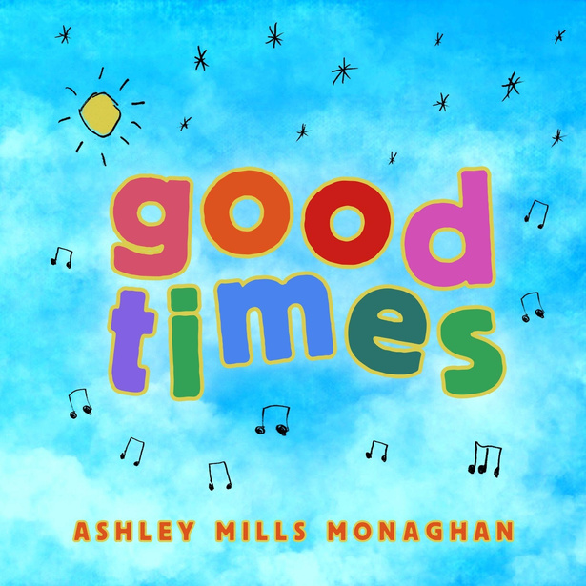
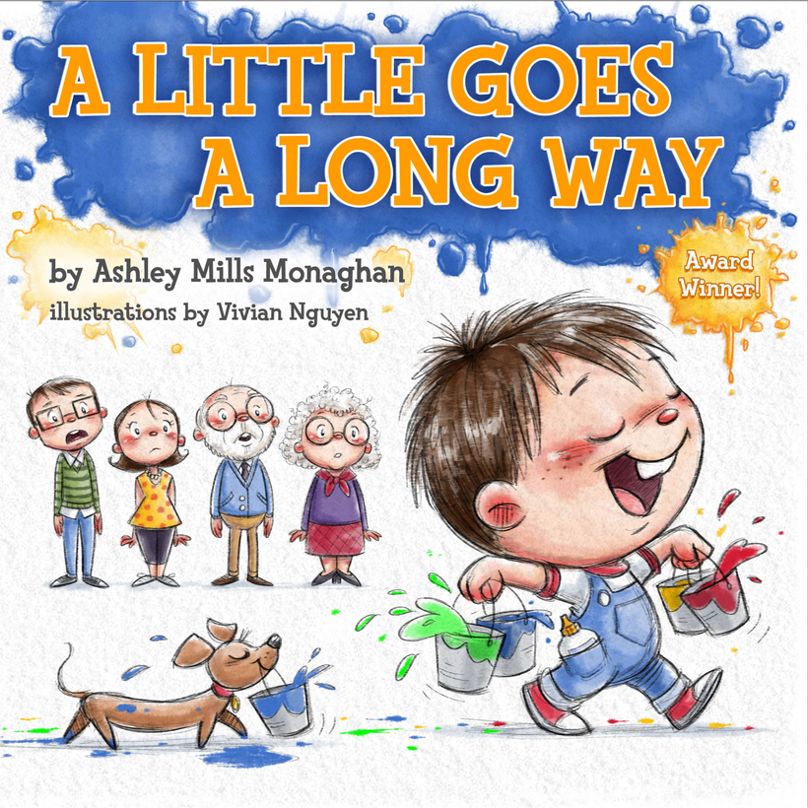


ASHLEY MILLS MONAGHAN
EDUCATION:
CHAPMAN UNIVERSITY (BFA FILM PRODUCTION AND MUSIC), SNMCI IRELAND (H.DIP)
EXPERIENCE:
ASHLEY MILLS MONAGHAN (ASHLEY MILLS MUSIC) IS AN AWARD WINNING CHILDREN’S MUSICIAN, PRODUCER, AUTHOR AND EARLY CHILDHOOD MUSIC EDUCATOR. AFTER TEACHING IN THE PRESCHOOL CLASSROOMS FOR OVER A DECADE, ASHLEY DECIDED TO FOCUS PRIMARILY ON MUSICAL ENDEAVORS. WHEN SHE IS NOT BUSY WITH RECORDING PROJECTS AND PERFORMING AT CHILDREN’S EVENTS, SHE RUNS HER MUSIC ENRICHMENT PROGRAM IN PRESCHOOLS AROUND HER COMMUNITY AND HOSTS MUSIC CLASSES THROUGH THE CRC IN WILMINGTON AND INGLEWOOD. OVER THE YEARS, SHE HAS WORKED HARD TO CREATE A MUSIC PROGRAM THAT COMBINES EARLY CHILDHOOD MUSIC EDUCATION, MUSIC THERAPY AND HER MONTESSORI TRAINING TO UTILIZE MUSIC AS A TOOL IN EARLY CHILDHOOD DEVELOPMENT AND LEARNING. SHE CONTINUES TO CREATE MUSIC FOR YOUNG CHILDREN (AND THEIR CAREGIVERS AND TEACHERS) AND HAS A THIRD ALBUM DUE OUT THIS YEAR. SHE HAS WON SEVERAL AWARDS OVER THE YEARS FOR HER CHILDREN’S BOOK AND MUSIC INCLUDING ‘FINALIST’ WITH INTERNATIONAL SONGWRITING CONTEST AND AN ‘HONORABLE MENTION’ WITH INTERNATIONAL READERS FAVORITE AWARD. SHE WAS ALSO THE VOICE OF “ANTOINETTE THE ANT” ON BUGS! AN ORIGINAL TONIE AND PLAYS ‘SADIE’ ON MS KYM’S MUSICAL PLACE ON YOUTUBE KIDS. ASHLEY IS A MEMBER OF ASCAP, CHILDREN’S MUSIC NETWORK AND THE RECORDING ACADEMY.
MEMBER OF: CHILDREN’S MUSIC NETWORK, ASCAP, INDIE COLLABORATIVE,
THE RECORDING ACADEMY

Slide 5



BENEFITS OF MUSIC
  Speech and language skills
  Neural activity growth
  Memory recall
  Pattern recognition
  Coordination
  Gross motor skills
  Ignites all areas of development for
  school readiness!
  Music is getting lost in schools
  Reduces stress hormones
ACCORDING TO KODALY, WE MUST TEACH MUSIC FROM A YOUNG AGE.
TRUE OR FALSE?

Slide 6



TRUE!
TEACHING MUSIC TO CHILDREN AS YOUNG AS BABIES CAN…
-INCREASE SENSORY DEVELOPMENT
-MAKE YOU FEEL BETTER!
-HELPS BUILD COORDINATION
-BUILDS VOCABULARY
-BONDING TIME
-IMPROVE LITERACY AND NUMERACY SENSE
-IMPROVES AUDIATION AND INNER HEARING
-BUILDING ON INNATE RHYTHMIC SENSE

Slide 7


IT’S ALL IN A RHYME
  When children hear rhyme and rhythm their brains begin to recognize sound patterns and build phonological awareness which is one of the earliest foundations for reading . These skills come out before sounding out words
Repetition and rhythm strengthen memory and focus and keeps them engaged longer
Reading aloud multiplies this effect: connects sounds to meaning, growing vocab, safe and motivated to listen
‘Go Boats Go’ ‘Night Train Night Train’ ‘Crane Jane’
‘There’s a Bear in my Chair’ ‘5 Little Ducks’
RHYMING = BUILDING SOUND PATTERNS

Slide 8
KEEP THAT BEAT NICE AND NEAT!
  MUSIC & LITERACY - Researchers link the ability to keep a steady beat to reading and language skills - the more accurate the children were at tapping along to the beat, the more consistent their brain response was to the speech syllable:
  RHYTHM plays crucial role in language processing including sentence structure and intonation. Enhancing one’s rhythm can build better comprehension skills by focusing on timing and flow of language, making it enjoyable and breaking down words and sounds
BETTER RHYTHM = BETTER FLUENCY IN READING

Slide 9


IMPROVING RHYTHMIC AWARENESS AND MUSICALITY AND READING SKILLS GO HAND IN HAND:
MUSIC ENHANCES LITERACY SKILLS BY STRENGTHENING AUDITORY PROCESSING, PHONOLOGICAL AWARENESS, GROSS AND FINE MOTOR SKILLS (FOR WRITING), VOCABULARY DEVELOPMENT - TARGETS EXECUTIVE FUNCTIONING SKILLS SUCH AS MEMORY AND RECALL AND HELPS BREAK APART WORDS TO UNDERSTAND SOUNDS AND RHYTHMIC PATTERNS WITHIN LANGUAGE - ABCS, 50 STATES…
MELODY = MEMORY

Slide 10
BEAT GAME
B.E.A.T I can play a steady beat
B.E.A.T play that beat now REST!
Move the BEAT around the body to feel the beat as clapping, tapping knees, tapping head, etc.
EXTENSION OPTIONS:
  Add melody
  Use MR BEAT and pass around the circle, make a game
  Add music notes with eliminated letters
  each time through, eliminate a letter - put it in your brain and say it in your head, not out your mouth
-INNATE RHYTHMIC SENSE
-inner hearing
-coordination
-complex thinking
-reading notes
COMING SOON!

Slide 11
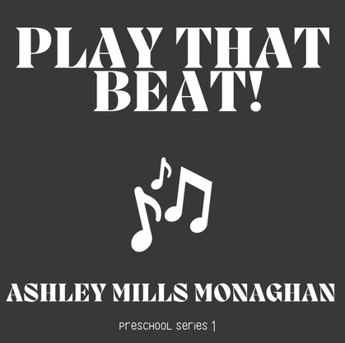
PLAY THAT BEAT!
Snap your fingers to the beat, keep it neat :I
Clap your hands to the beat, keep it neat :I
CHORUS:
Reach up high, bend down low
Turn around in a circle
Elbows wide, move ‘em side to side
Now groove to the beat, but keep it neat
And take a boogie break
Move any way you like..
NOW FREEZE!
Tap your knees to the beat, keep it neat :I
Flap your arms to the beat, keep it neat :I
CHORUS
Stomp your feet to the beat, keep it neat :I
Shrug your shoulders to the beat, keep it neat :I
CHORUS
BOOGIE!!
MUSICAL OBJECTIVES:
RHYTHMIC SENSE
FEELING THE BEAT, STAYING ON TOP OF THE BEAT
SPATIAL AWARENESS
GROSS MOTOR SKILLS
ACTIVE LISTENING SKILLS
BODY PARTS
SELF EXPRESSION
FUN!
LISTEN ANYWHERE!

Slide 12
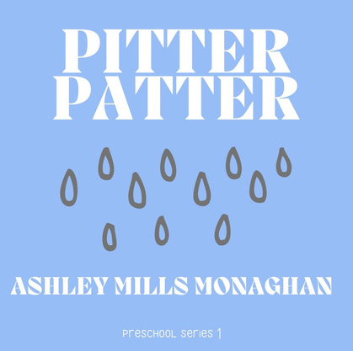
PITTER PATTER
Pitter patter pitter patter
Rain is falling down
Pitter patter pitter patter
The wind is howling now
oooh oooh oooooooooh
ooooh oooh ooooooooooooh
Repeat 3 more times, each time faster (moderato then presto - last time through slow it back down moderato then back to largo)
-MUSICAL VOCAB
-2 PARTS TO SONG
-TEMPO
-FEELING THE BEAT
-FUN
COMING SOON!

Slide 13
SINGABLE STORIES!
DOWN BY THE BAY
OVER IN THE MEADOW
SHAKE YOUR SILLIES OUT
THE TORTOISE AND THE HARE (LEARNING NOTES AND TEMPO)
IT’S SPRING
5 LITTLE DUCKS
THE GREEN GRASS GROWS ALL AROUND
LITTLE OWL’S NIGHT
MUDDY PUDDLES BY LAURA DOHERTY
LOS MAS PEQUENOS BY MUSICA BY NATHALIA
GAMES/ACTIVITES/FINGERPLAY POEMS!
CLAP AND REPEAT, YES/NO GAME, DO AS I SAY NOT AS I DO! FILL UP MY BALLOON, TAP TAP
-HERE IS THE BEEHIVE, OPEN SHUT THEM, 5 LITTLE BUNNIES

Slide 14
SONGS USING PROPS
BENEFITS OF USING PROPS FOR YOUR STORYTIME SESSIONS:
GROSS AND FINE MOTOR SKILLS
ENGAGEMENT
INTENTIONAL LESSONS WITH SONGS
What kind of props do you use?
felt board
finger puppets
scarves
laminates
parachute
stretchy band
canopy scarf

Slide 15
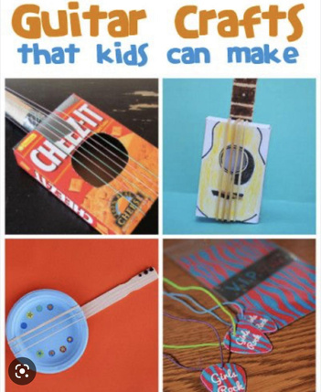

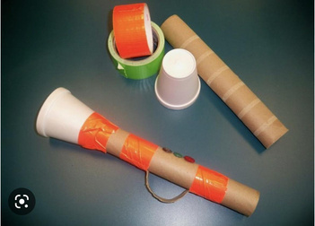
FUN WITH PERCUSSION INSTRUMENTS!
FUN SONGS FOR YOUR SHAKERS:
“I KNOW A CHICKEN” LAURIE BERKNER BAND
“THE EGG SHAKER SONG” MR Q
“THE SHAKER SONG” STACEY PEASELY BAND
ACTIVITIES:
OLD MACDONALD IN A BAND
WHEELS ON THE BUS
IF YOU’RE HAPPY AND YOU KNOW IT
MAKE AN INSTRUMENT - SHAKER, HARMONICA, GUITAR
A PERCUSSION INSTRUMENT IS ANY INSTRUMENT THAT MAKES ITS SOUND WHEN YOU HIT IT SHAKE IT OR SCRAPE IT
RHYTHM STICK FUN
TAP YOUR STICKS WITH ME
TAP YOUR STICKS (HAP PALMER)
USE POPSICLE STICKS OR FINGERS IF YOU DON’T HAVE STICKS

Slide 16
FUN WITH SCARVES!
Scarf Songs/Poems:
Peek a Boo!
Blooming flower (Our Garden Grows by Ashley Mills Music)
Butterfly Butterfly
Scarf Song (Ashley Mills Music)
Windy Day (Judi Cranston)
I’ve Got a Scarf in My Hand (Stacey Peaseley)
Popcorn! (Kymberly Stewart)
Little Ghost
Falling Leaf
Jelly on a Plate (Judi Cranston)
BENEFITS OF USING SCARVES:
GROSS AND FINE MOTOR SKILLS
ENGAGEMENT
INTENTIONAL LESSONS WITH SONGS
CANOPY SCARF
pair with this song:
Balloon (Lucy Kalantari)
Use balloons to float and play keepy uppy

Slide 17
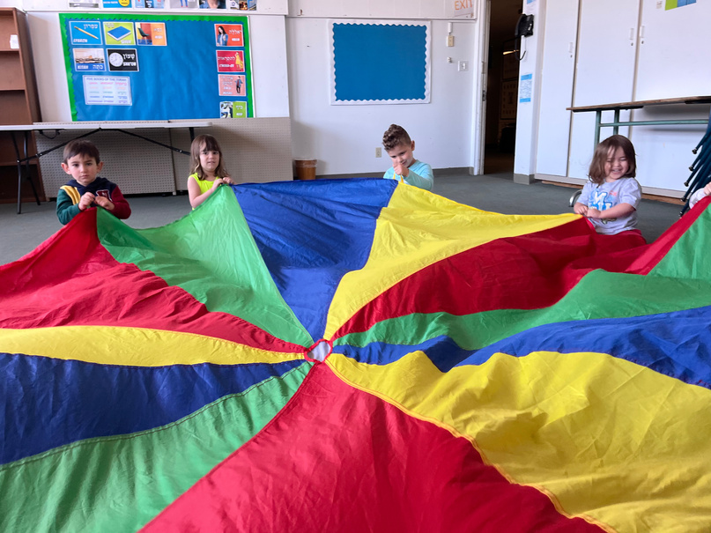
FUN WITH THE PARACHUTE!
KEEPY UPPY WITH “BALLOON” (LUCY KALANTARI)
Row Row (Judi Cranston)
Row your Boat
5 little monkeys
shake and stop (vocab opportunity for musical terminology largo/presto)
‘El Gat i El Ratoli’ (Bellaterra Musica Ed)
‘Creeping Cats&Sleeping Bats (Stacey Peasely Band)
ACTIVITES:
PLAY KEEPY UPPY WITH BALLOONS OR BEACH BALLS
USE FELT SNOWFLAKES/LEAVES
PARACHUTES ARE GREAT FOR TEACHING ABOUT TEMPO - HOW FAST OR SLOW WE GO IN MUSIC LARGO = SLOW PRESTO = FAST
STRETCHY BAND FUN
ROW ROW YOUR BOAT, BOUNCE TO THE BEAT
HTTPS://WWW.YOUTUBE.COM/WATCH?V=PHTHJJZCONO

Slide 18
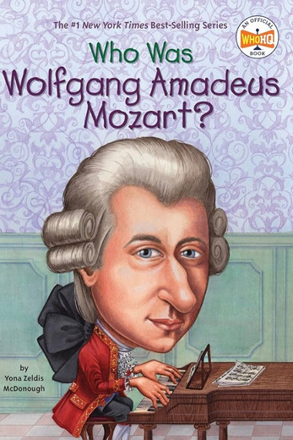
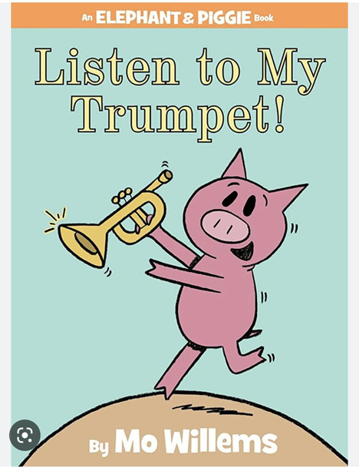
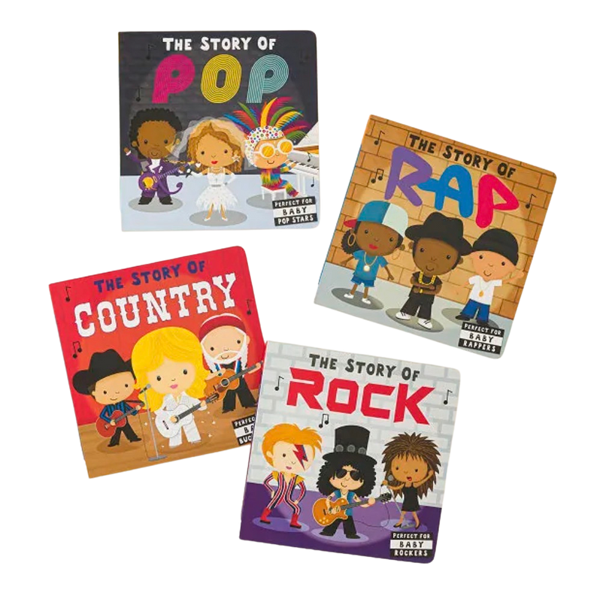
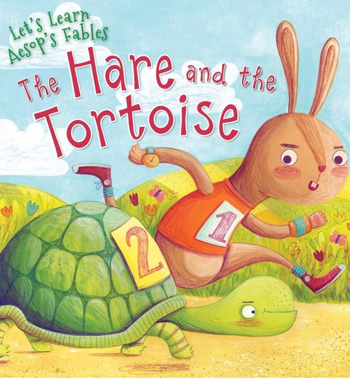
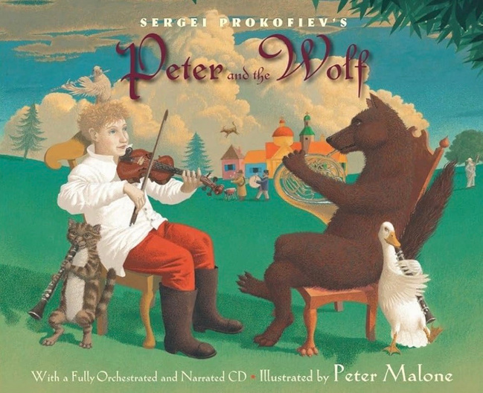
BOOKS ALL ABOUT MUSIC!
THEMES
FAMILIES OF INSTRUMENTS
COMPOSERS
MUSIC FROM AROUND THE WORLD
HTTPS://YOUTU.BE/MBD_WHBJUP8?SI=Q4ZUUHMIC157K75T
THE TORTOISE AND THE HARE

Slide 19

Having a ‘bag full’ of attention grabbers or listening games to help distract or transition is essential! BONUS - if you make it musical your kiddos are getting even more exposure to the magic!
WHAT’S IN YOUR BAG?
“HANDS UP, HANDS DOWN, PUT A BUBBLE IN YOUR MOUTH”
CLAPPING RHYTHMS
YES NO
WATERFALL WATERFALL
IF YOU CAN HEAR ME TAP YOUR…
DO AS I SAY NOT AS I DO
CAN I HAVE YOUR *ATTENTION PLEASE….WHEN THE TEACHER IS TALKING THE CHILDREN ARE *LISTENING, …1 2 3 CLAP YOUR HANDS WITH ME, …IT IS TIME FOR CIRCLE TIME! (WE WILL ROCK YOU!) MINDFUL MOMENTS, CLAP AND REPEAT,
BEAT GAME
BLOW UP YOUR BALLOON
TAP TAP TAP

Slide 20
TYPICAL CLASS ROUTINE
DANCE PARTY
PERCUSSION INSTRUMENT FUN:
OLD MACDONALD IN A BAND, WHEELS ON THE BUS, IF YOU’RE HAPPY AND YOU KNOW IT, EGG SHAKER SONG BY MR Q
(CLEAN UP SONG)
*ABC/123/NEW SONG/FINGERPLAY POEM
SCARF FUN
PEEK A BOO, BLOOMING FLOWER, POPCORN! SCARF SONG, I’VE GOT A SCARF IN MY
HAND, WINDY DAY
(CLEAN UP SONG)
SINGABLE STORY
PARACHUTE
BUBBLES!
OTHER THEMES:
MUSICAL NOTATION
COMPOSING RHTYHMS
TEMPO & DYNAMICS
MINDFULNESS AND YOGA
FELT BOARD AND LAMINATED VISUALS
FAMILIES OF INSTRUMENTS
COMPOSERS
WRITING AND PRODUCING A SONG
SINGABLE STORIES
USING PROPS: SCARVES, CANOPY SCARF, BALLOONS, BUBBLES, SPRAY BOTTLES, BELLS, BANGERS, RAIN STICKS, RHYTHM STICKS, SHAKERS, PERCUSSION INSTRUMENTS…
ROUTINE, REPETITION AND ALTERNATING SONGS/STORIES/ACTIVITIES WORKS BEST FOR FAMILIES AND CHILDREN

Slide 21
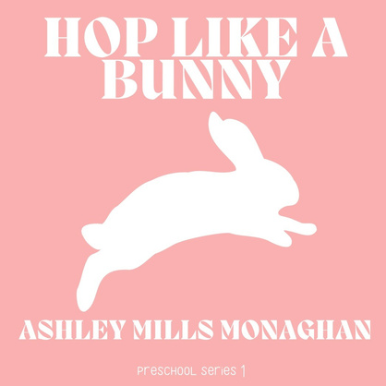
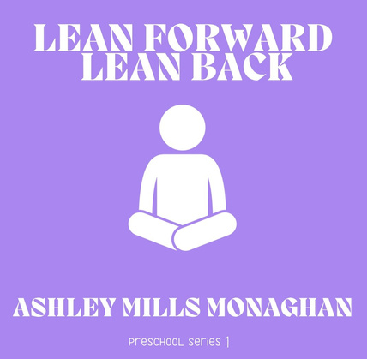
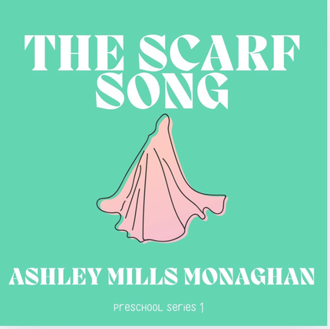
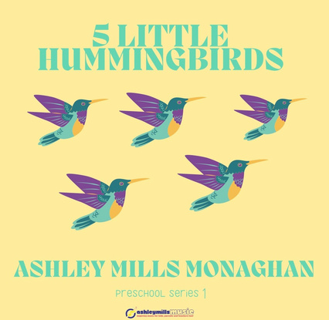





ASHLEY MILLS MONAGHAN
HELPING YOUR TODDLER THROUGHOUT THE DAY:
RISE AND SHINE
TOOTHBRUSH
ABC SONG
123S
CLEAN UP SONG
MOVE LIKE ANIMALS
TAKING TURNS
GOOD TIMES -
DESIGNED FOR CHILDREN, PARENTS AND TEACHERS TOO!
LET’S MAKE COOKIES (TRACK 2)
WIGGLES (TRACK 3)
OUR GARDEN GROWS (TRACK 4)
THE COLOR SONG (TRACK 6)
HAPPY FEET! (TRACK 7)
I BELONG MANTRA (TRACK 9)
LEARN THE FLOWER LIFE CYCLE, EXPAND VOCABULARY, SENSORY, REPETITIVE, CATCHY, HAND MOTIONS, USE FOR YOUR SPRING SING CONCERT! BACKING TRACK AVAILABLE.
VISUALS ON WEBSITE.

Slide 22
ASHLEY MILLS MONAGHAN
‘A LITTLE GOES A LONG WAY’
  USE AT THE BEGINNING OF THE YEAR TO REITERATE CLASSROOM RULES
  USE AROUND EARTH DAY (OR EVERYDAY!) TO TEACH THE IMPORTANCE OF MODERATION, CONSERVATION AND PRESERVATION
  VISIT WEBSITE MONTHLY FOR NEW ACTIVITY
  NEW SONG COMING SOON!
  AVAILABLE ON AUDIBLE AND STREAMING EVERYWHERE
  DOWNLOAD YOUR FREE COPY OF AUDIO BOOK ON WEBSITE NOW (EXPIRES MONDAY)
  ART PROJECT ONLY WORKS WHEN YOU USE ONLY WHAT YOU NEED!
  WATCH VIDEO OF THE BOOK AND LEARN HOW TO DRAW SAUSAGES WITH VIVIAN!
  AVAILABLE FOR PURCHASE (LIMITED COPIES $14) AND ON AMAZON

Slide 23
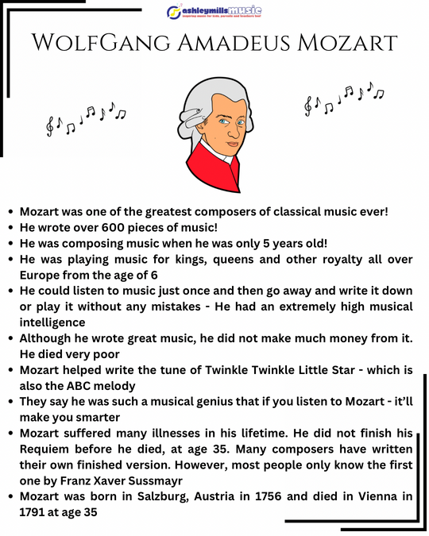
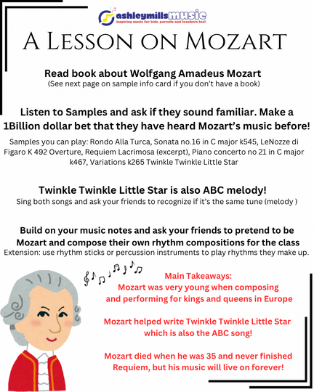
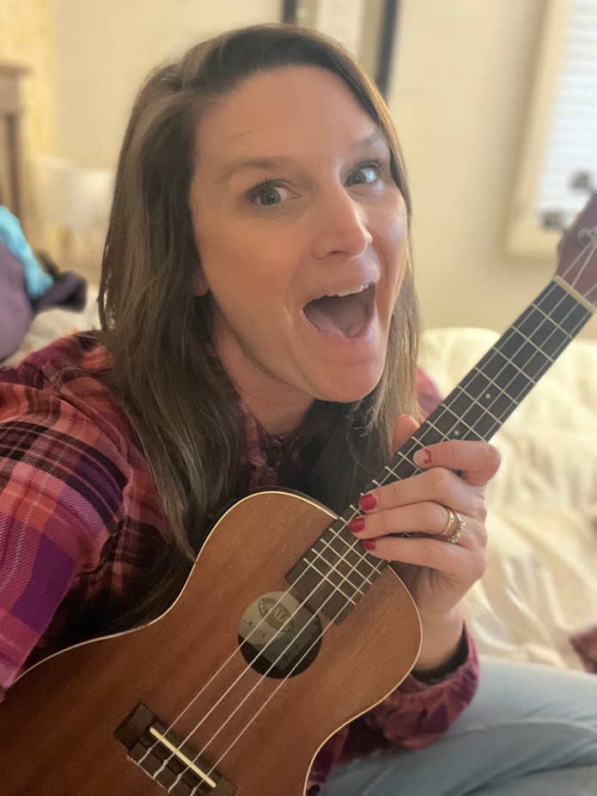
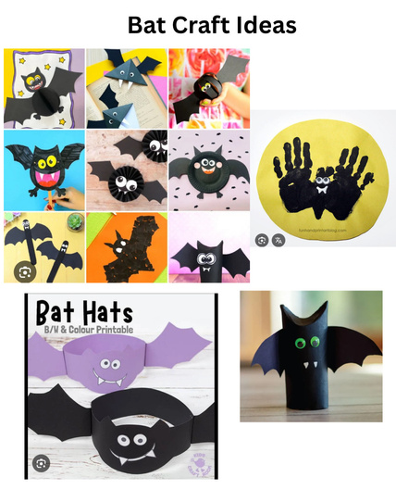
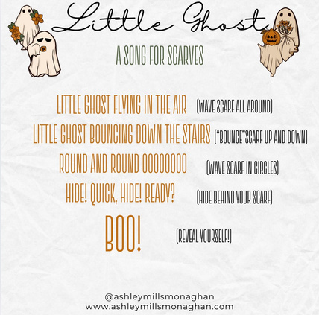
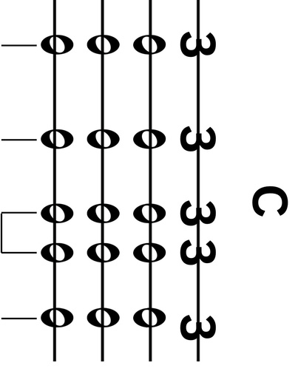
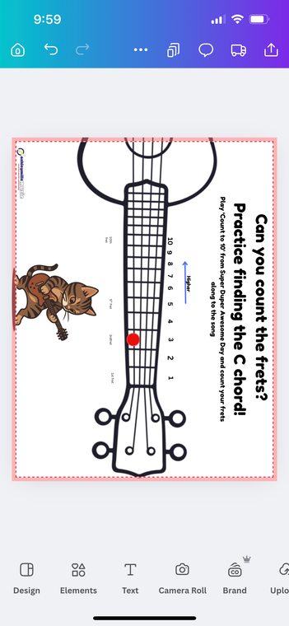
ASHLEY MILLS MONAGHAN
FOLLOW ME ON INSTAGRAM WHERE I POST TUTORIAL VIDEOS AND LESSON PLAN IDEAS FOR YOUR CLASSES!
@ASHLEYMILLSMONAGHAN

Slide 24
ARTISTS I USE AND RECOMMEND:
MISS NINA
LAURIE BERKNER BAND
KIRA WILLEY
LUCY KALANTARI AND THE JAZZ CATS
JOANIE LEEDS
KIBOOMERS
MUSIC WITH MICHAL
UNCLE DOX
CHARLOTTE DIAMOND
NANCY KOPMAN
MISS MELODEE
JACK HARTMANN
JUDI CRANSTON
STEPHANIE LEAVELL (MUSIC FOR KIDDOS)
STACEY PEASELY
KYLE RILEY
KYMBERLY STEWART
JUDI CRANSTON
DIVINITY ROXX
NATHALIA MUSICA
MUSIC THERAPY JOY (PATINA JACKSON)
ADDITIONAL RESOURCES:
@LALALIBRARIANMUSIC
MUSIC FOR KIDDOS

Slide 25



THANK YOU
WWW.ASHLEYMILLSMONAGHAN.COM
ASHLEYMILLSMONAGHAN@GMAIL.COM
REFERENCES:
SCIENCE DIRECT
INTERNATIONAL LITERACY ASSOCIATION
WEBINAR WITH DENISE GAGNE
MUSIC FOR KIDDOS
HTTPS://WWW.MUSICFORKIDDOS.COM/BLOG/STRETCHY-BAND-SONGS-FOR-PRESCHOOL-AND-KINDERGARTEN-MUSIC-TIME
DALCROZEUSA.ORG
KODALY MUSIC INSTITUTE
MUSICTHERAPY.ORG

